Slide 1

8th Grade Math: Pre-Algebra
Unit 14, Lesson 5 Calculating Theoretical Probability of Compound Events Volume 2, pg. 331

Slide 2


Benchmark
MA.8.DP.2.2
Find the theoretical probability of an event related to a repeated experiment.
volume 2, pg. 331

Slide 3
Integrated Mathematical Thinking and Reasoning Standards
MA.K12.MTR.1.1 Actively participate in effortful learning both individually and collectively.
MA.K12.MTR.3.1 Complete tasks with mathematical fluency.
volume 2, pg. 331

Slide 4

Learning Target
I can calculate theoretical probability of compound events.
volume 2, pg. 331

Slide 5

Warm-Up
volume 2, pg. 332

Slide 6
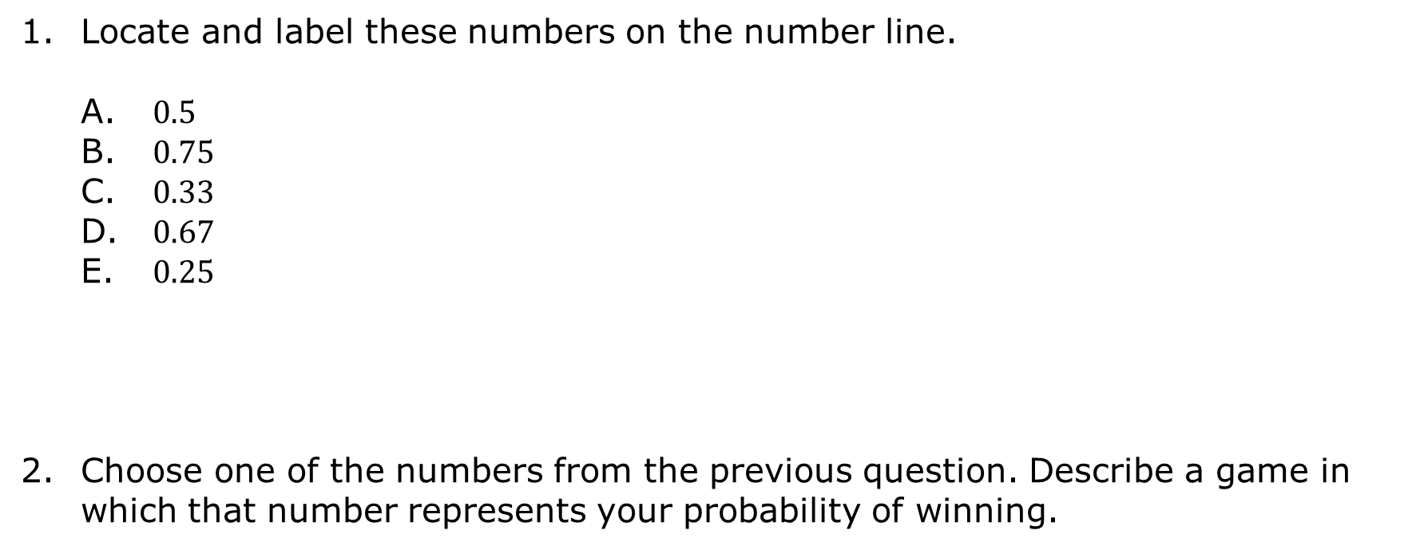
14.5.1 Warm-Up: Ordering Probabilities
Locate and label these numbers on the number line.
$0.5$
$0.75$
$0.33$
$0.67$
$0.25$
Choose one of the numbers from the previous question. Describe a game in which that number represents your probability of winning.
volume 2, pg. 332

Slide 7

Activity
volume 2, pg. 332

Slide 8

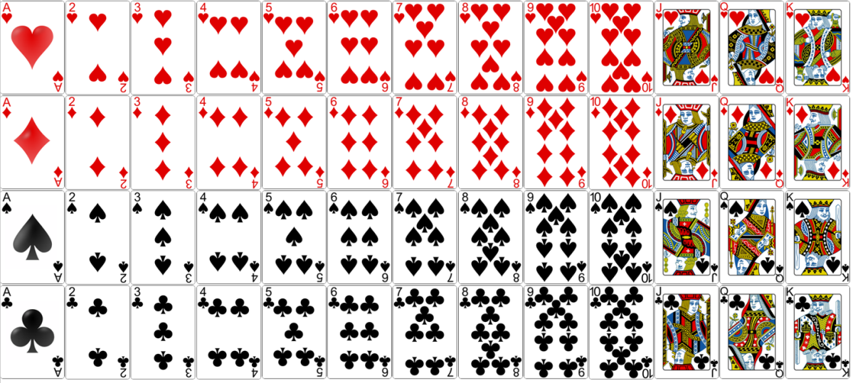
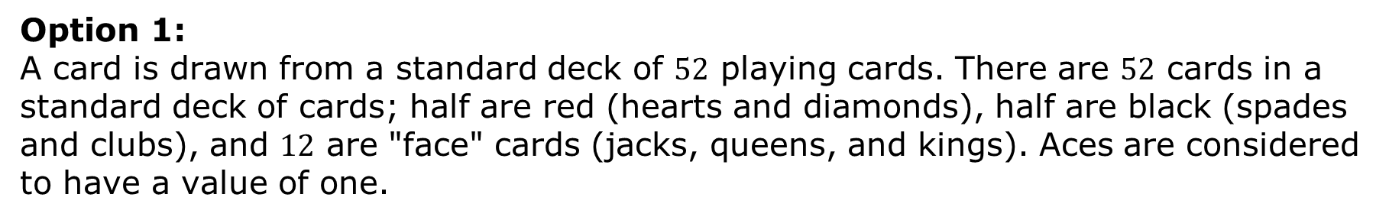
14.5.2 Activity: Make Your Own Game
Option 1:
A card is drawn from a standard deck of $52$ playing cards. There are $52$ cards in a standard deck of cards; half are red (hearts and diamonds), half are black (spades and clubs), and $12$ are "face" cards (jacks, queens, and kings). Aces are considered to have a value of one.
volume 2, pg. 332

Slide 9
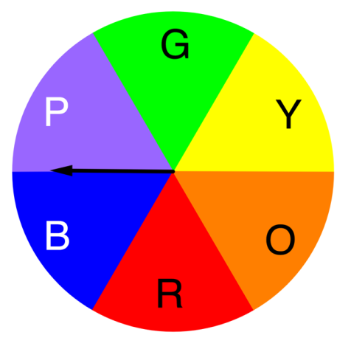
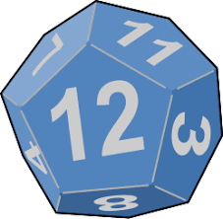

Option 2:
The fair spinner, shown, is spun.
Option 3:
A fair $12$-sided die is rolled.
volume 2, pg. 332

Slide 10
Work with your partner to complete the following.
Step 1: Choose any two simple experiments from the options provided.
Step 2: Create a game with your partner using the two options you chose.
Describe the game you created.
Determine the number of outcomes in the sample space.
volume 2, pg. 333

Slide 11
Define Event A = the outcomes resulting in a win.
Event A =
How many outcomes are in Event A?
List the outcomes in Event A.
volume 2, pg. 333

Slide 12
What is the probability of winning your game?
Switch games with another partner pair. Verify their work.
Make any adjustments necessary to your game based on the other partner pair’s review of your game.
volume 2, pg. 333

Slide 13

Guided Practice
volume 2, pg. 334

Slide 14

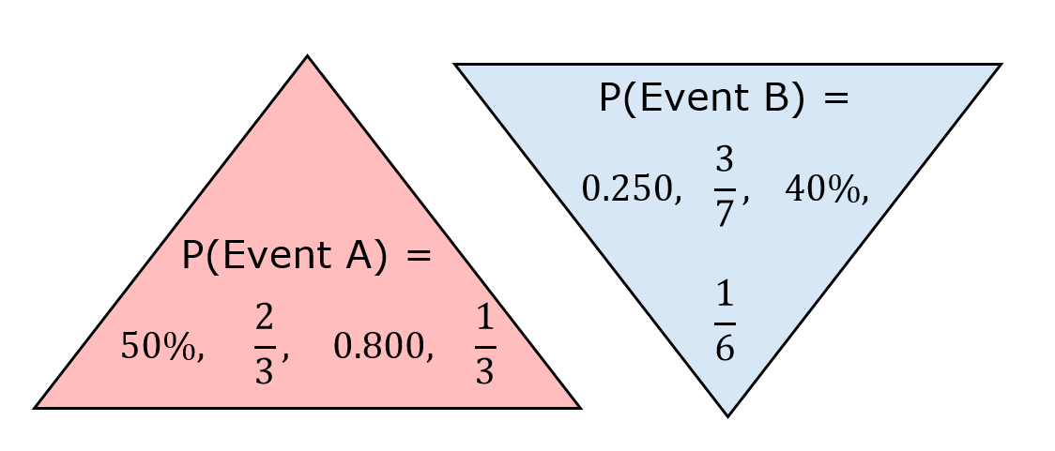
14.5.3 Guided Practice: Calculating Probability
Choose a probability of Event A from the P(A) triangle. Choose a probability of Event B from the P(B) triangle. Use those probabilities to calculate P(A and B). In your work, use P notation to specify which probability you are using: P(A), P(B), and P(A and B).
volume 2, pg. 334

Slide 15
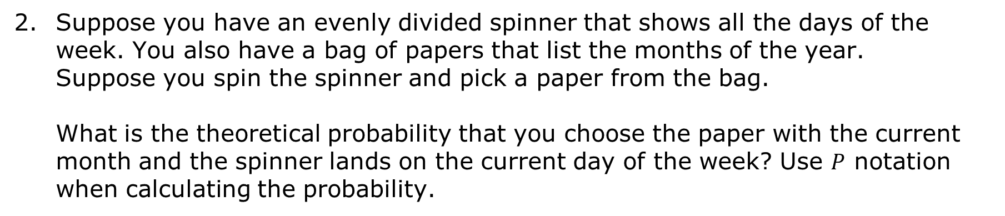
Suppose you have an evenly divided spinner that shows all the days of the week. You also have a bag of papers that list the months of the year. Suppose you spin the spinner and pick a paper from the bag.
What is the theoretical probability that you choose the paper with the current month and the spinner lands on the current day of the week? Use $P$ notation when calculating the probability.
volume 2, pg. 334

Slide 16

Try It
volume 2, pg. 335

Slide 17

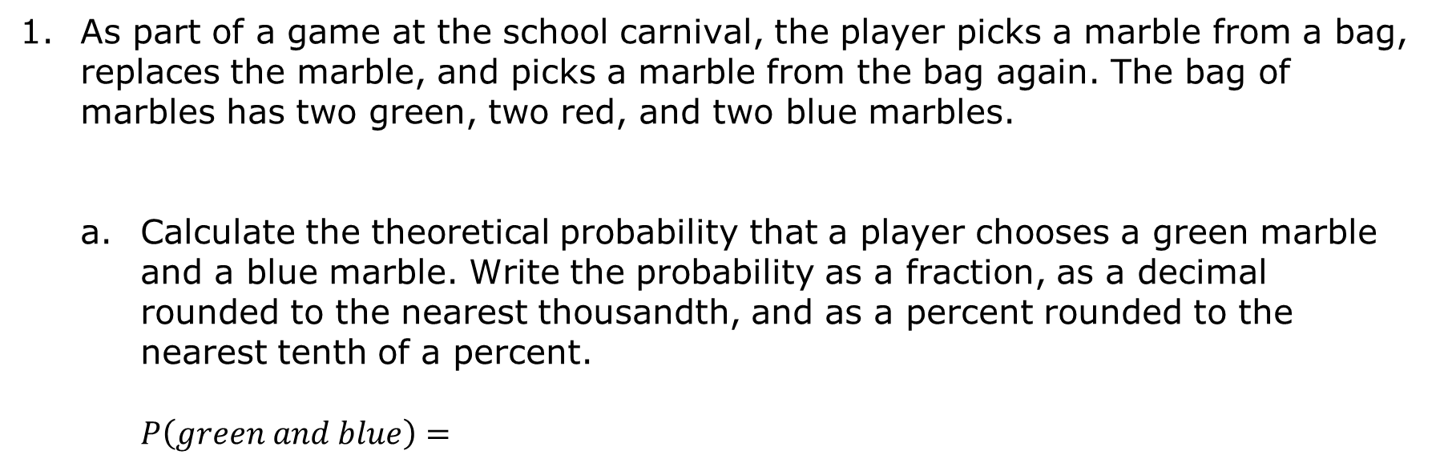
14.5.4 Try It: Calculating Probability
As part of a game at the school carnival, the player picks a marble from a bag, replaces the marble, and picks a marble from the bag again. The bag of marbles has two green, two red, and two blue marbles.
Calculate the theoretical probability that a player chooses a green marble and a blue marble. Write the probability as a fraction, as a decimal rounded to the nearest thousandth, and as a percent rounded to the nearest tenth of a percent.
$$P\left(green and blue\right)=$$
volume 2, pg. 335

Slide 18
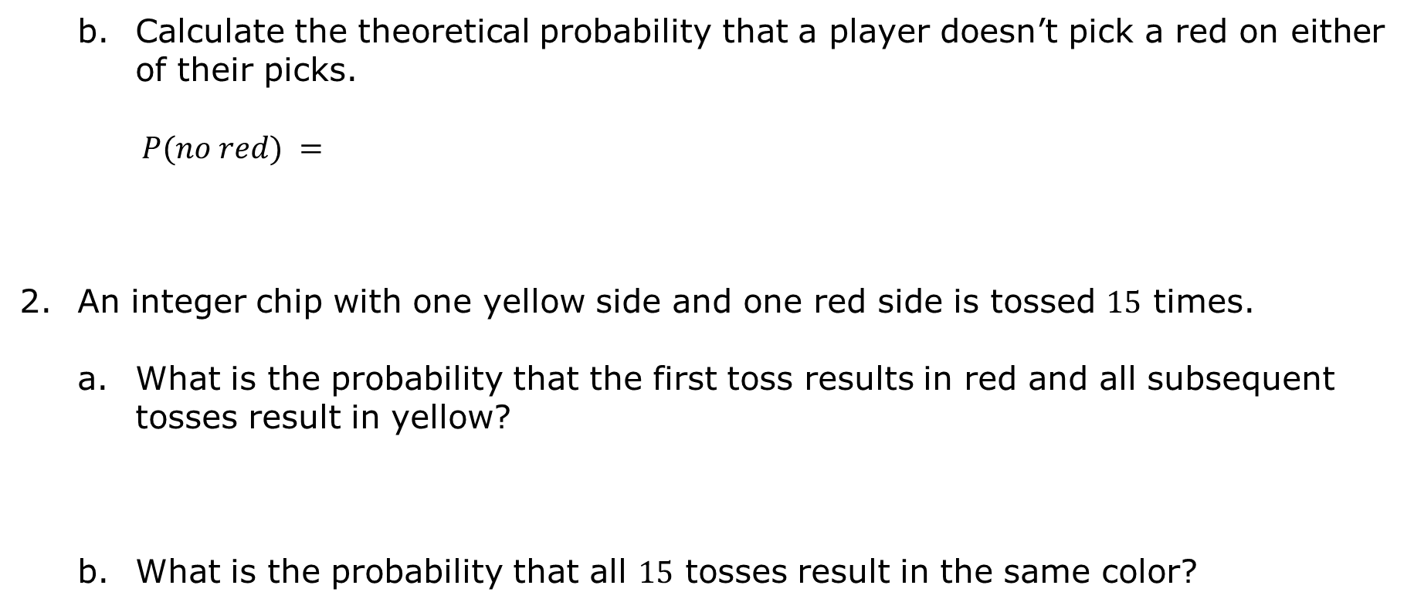
Calculate the theoretical probability that a player doesn’t pick a red on either of their picks.
$$P(no red) =$$
An integer chip with one yellow side and one red side is tossed $15$ times.
What is the probability that the first toss results in red and all subsequent tosses result in yellow?
What is the probability that all $15$ tosses result in the same color?
volume 2, pg. 335

Slide 19

Your Turn
volume 2, pg. 336

Slide 20
14.5.5 Your Turn!
Although she would like to have more, Wanda is only allowed to have two pets total. She is allowed to choose from these three options: a dog, a cat, and a rabbit. Wanda has decided to use a die to randomly choose which two pets she will have. If she rolls a 1 or a 2, she will get a dog, if the die lands on a 3 or 4 she will get a cat, and she will get a rabbit if the die lands on 5 or 6.
Calculate the theoretical probability that Wanda will end up with two cats.
volume 2, pg. 336

Slide 21
A textbook has exactly 428 pages numbered in order starting with 1 and ending with 428. You flip to a random page in the book in a way that it is equally likely to stop at any of the pages. Then you repeat the process.
Consider Event N, turning to an odd numbered page three times in a row.
Calculate the theoretical probability of Event N.
volume 2, pg. 336

Slide 22

Wrap-Up
volume 2, pg. 337

Slide 23

14.5.6 Wrap-Up: Reflection
What was the muddiest (most difficult or confusing) point in today’s lesson on calculating theoretical probability?
volume 2, pg. 337

